Slide 1
Pointers and Array-Based lists
Presentation Members:
Faizan Ul Islam
Muhammad Shahzad
Saeed Ahmad
Usama Bin Hafeez

Slide 2
Contents
The Pointer Data Type and Pointer Variables
Classes and Pointers
Inheritance, Pointers and Virtual Functions
Abstract Classes and Pure Virtual Functions
Array-Based Lists

Slide 3
The Pointer Data Type and Pointer Variables
Pointer variable:
A variable whose content is an address (that is, a memory address.
In C++, you declare a pointer variable by using the asterisk symbol (*) between the data type and the variable name.
As an example, consider the following statements:
int *p;
char *cu;

Slide 4
The Pointer Data Type and Pointer Variables
Address Of Operator(&):
In C++, the ampersand,&, called the address of operator, is a unary operator that returns the address of its operand. For example, given the statements
int x ;
int *p ;
the statement
p = &x;
assigns the address of ‘x’ to ‘p’. That is, ‘x’ and the value of ‘p’ refer to the same memory location.

Slide 5
The Pointer Data Type and Pointer Variables
Dereferencing Operator (*):
The dereferencing operator (*) refers to the object to which the operand of the (*) (that is, the pointer) points. For example, given the statements
int x = 25;
int *p;
p = &x; //store the address of x in p
the statement
cout << *p << endl;
prints the value stored in the memory space to which ’p’ points, which is the value of ‘x’.

Slide 6
The Pointer Data Type and Pointer Variables
Initializing Pointer Variables:
Pointer variables are initialized using the constant value 0, called the null pointer. Thus,
the statement
p = 0;
stores the null pointer in p;
that is p points to nothing. Some programmers use the named constant NULL to initialize pointer variables. The following two statements are equivalent:
p = NULL;
p = 0;

Slide 7
The Pointer Data Type and Pointer Variables
Dynamic Variables:
Variables that are created during program execution are called dynamic variables.
With the help of pointers, C++ creates dynamic variables. C++ provides two operators , new and delete, to create and destroy dynamic variables, respectively. When a program requires a new variable, the operator new is used. When a program no longer needs a dynamic variable, the operator delete is used.

Slide 8
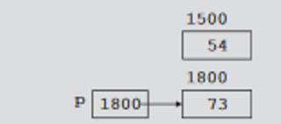
The Pointer Data Type and Pointer Variables
Operator new and delete:
int *p;
p = new int;
*p=18;
delete p;
For dynamic array
int *a;
a=new int[ ];
delete [ ] a;

Slide 9
The Pointer Data Type and Pointer Variables
Memory Leak:
int *p;
This statement declares p to be a pointer variable of type int. Next, consider the following statements:
p = new int; //Line 1
*p = 54; //Line 2
p = new int; //Line 3
*p = 73; //Line 4
Now first memory space is
Inaccessible which results in
Memory leak.

Slide 10

The Pointer Data Type and Pointer Variables
Shallow vs Deep Copy Pointers:
int *first;
int *second;
Further suppose that first points to an int array, as shown :
Next, consider the following statement:
second = first;

Slide 11

The Pointer Data Type and Pointer Variables
Shallow vs Deep copy Pointers:
After this statement executes ,both first and second points to the same array, as shown in:
Let us execute the following statement:
delete[ ] second;
executes , first becomes invalid, that is, first(as well as second) are now dangling pointers.

Slide 12
The Pointer Data Type and Pointer Variables
Shallow vs Deep Copy:
Now if we want to access first either it will access wrong memory or the program will terminate this is a example of shallow copy.
On the other hand, suppose that instead of the earlier statement , second = first;(in Line A), we have the following statements:
second = new int[10];
for (int j = 0; j < 10; j++ )
second[j]= first[j];
Both first and second now point to their own data. If second deletes its memory , there is no effect on first. This case is an example of a deep copy. More formally, in a deep copy, two or more pointers have their own data.

Slide 13
Classes: Some Pecularities
Whenever we have a pointer as a data member in our class we must take care about some points. We must separately define our own:
Destructor
Assignment operator
Copy Constructor

Slide 14
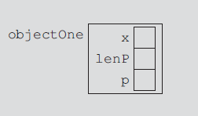
WHY AND HOW?
Destructor:
Suppose we have an object of a class that has a pointer p as shown in fig;

Slide 15
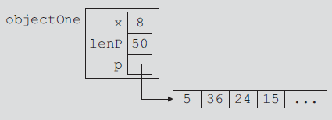
Assume during execution the pointer p creates a dynamic array
When an object goes out of scope (destroy) it’s member variable are destroyed by default destructor.
The memory space of the dynamic array would stay as marked because dynamic memory must be deallocated using the operator delete.
we must put the necessary code in the destructor to ensure that when object goes out of scope, the memory created by the pointer p is deallocated.

Slide 16
How to deallocate memory using coding?
The definition of destructor is as follows
classname :: ~ classname()
{
delete [] pointer_variable;
}

Slide 17
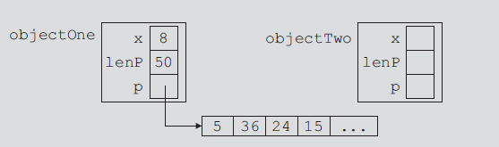
Assignment Operator
Suppose we have two objects

Slide 18
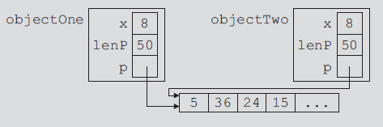
The statement: objectTwo = objectOne; copies the member variables of objectOne into objectTwo.
if objectTwo.p deallocates the memory space to which it point objectOne.p would become invalid.
This concept is known as shallow copying. To avoid shallow copy we must overload (define) our own assignment operator.

Slide 19
OVERLOADING THE ASSIGNMENT OPERATOR
Function Definition:
const className& className::operator=(const className& rightObject)
{
//local declaration, if any
if (this != &rightObject) //avoids self-assignment
{
//algorithm to copy rightObject into this object
}
//returns the object assigned
return *this;
}
The return type of the function to overload the assignment operator is a reference. This is so that the statements such as x = y = z; can be executed

Slide 20
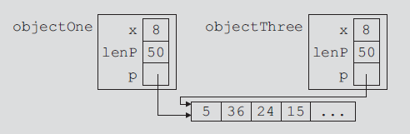
Copy Constructor
When declaring a class object, you can initialize it by using the value of an existing object of the same type.
pointerDataClass objectThree(objectOne);
This initialization is called the default memberwise initialization. The default memberwise initialization is due to the constructor, called the copy constructor (provided by the compiler).

Slide 21
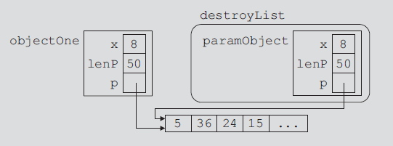
void destroyList(pointerDataClass paramObject);
destroyList(objectOne)
If a class has pointer member variables:
• During object declaration, the initialization of one object using the value of another object leads to a shallow copying of the data, if the default memberwise copying of data is allowed.
• If, as a parameter, an object is passed by value and the default memberwise copying of data is allowed, it leads to a shallow copying of the data.
we can overcome this shallow copying problem by including the copy constructor

Slide 22
The copy constructor automatically executes in three situations
• When an object is declared and initialized by using the value of
another object
• When, as a parameter, an object is passed by value
• When the return value of a function is an object
General syntax:
className(const className& otherObject);
For classes with pointer member variables, three things are normally done:
1. Include the destructor in the class.
2. Overload the assignment operator for the class.
3. Include the copy constructor.

Slide 23
Inheritance, Pointers and Virtual Functions
Inheritance
Inheritance is one of the key features of Object-oriented programming in C++. It allows user to create a new class (derived class) from an existing class(base class).
The derived class inherits all the features from the base class and can have additional features of its own.
Base Class
Derived Class
Feature 1
Feature 2
Feature 1
Feature 2
Feature 3

Slide 24
Inheritance, Pointers and Virtual Functions
Public Inheritance:
Private and protected members of the base class become
the private and protected members of the derived class
respectively.
Protected Inheritance:
Public and protected members of the base class become
protected member of the derived class.
Private Inheritance:
Public and protect members of the base class become
private members of the derived class.

Slide 25
Inheritance, Pointers and Virtual Functions
Static Binding
It is also called compile-time binding
The necessary code to call a specific function is generated by the compiler
Dynamic Binding
It is also called run-time binding
Virtual functions are used to create this type of binding, it allows us to override the function in the derived classes
The binding of virtual functions occurs at program execution time, not at compile time.

Slide 26
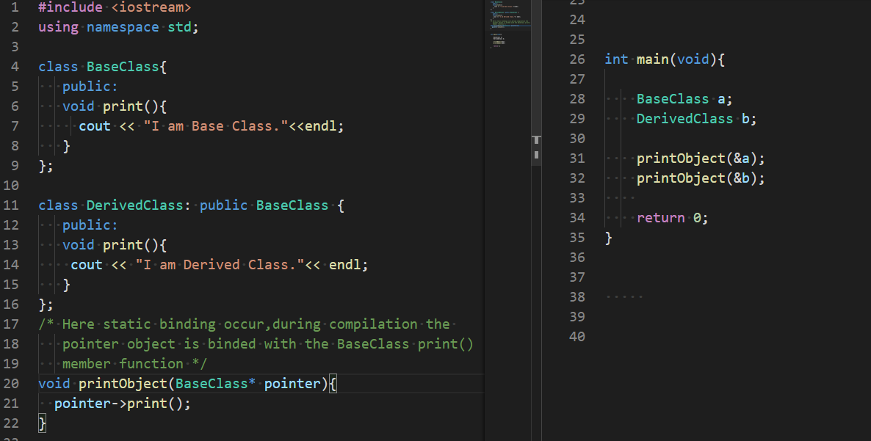

Inheritance, Pointers and Virtual Functions
Static Binding

Slide 27
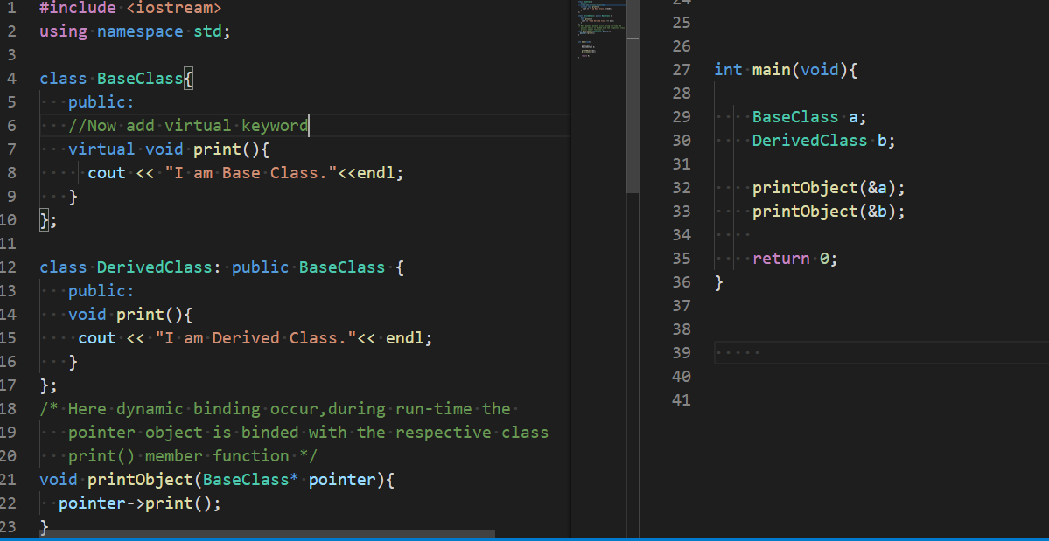

Inheritance, Pointers and Virtual Functions
Dynamic Binding

Slide 28
Abstract Classes and Pure Virtual Functions
Abstract Class
A class which contain one or more pure virtual functions
Pure Virtual Functions
It is a special kind of function which must be overridden by any
derived class
This function is indicated in the declaration with the syntax “=0”
functions' declaration
This function has no definition.

Slide 29
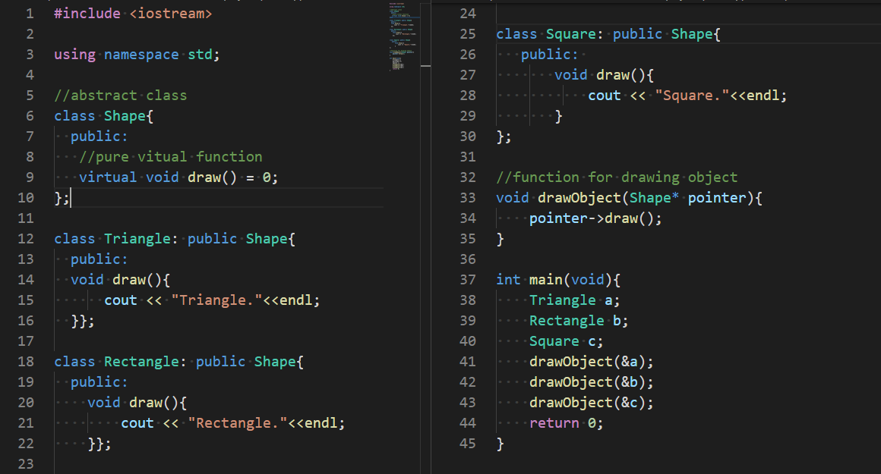

Abstract Classes and Pure Virtual Functions

Slide 30

Array-Based Lists
List:
A collection of elements.
elements must be of the same type.
The length of a list is the number of elements in the list.

Slide 31
Array-Based Lists
Operations performed on a list:
1. Create the list. The list is initialized to an empty state.
2. Determine whether the list is empty.
3. Determine whether the list is full.
4. Find the size of the list.
5. Destroy, or clear, the list.
6. Insert an item in the list at the specified location.
7. Remove an item from the list at the specified location.
8. Replace an item at the specified location with another item.
9. Retrieve an item from the list from the specified location.
10. Search the list for a given item.

Slide 32
Array-Based Lists
Why we use array for implementation of list:
Because all the elements of a list are of the same type, an effective and
convenient way to process a list.
Initially, the size of the array holding the list elements is usually larger
Than the number of elements in the list so that, at a later stage,
the list can grow.

Slide 33
Array-Based Lists
Implementation:
To process the list in an array, we need three variables:
The array holding the list elements.
A variable to store the length of the list
(that is, the number of list elements currently in the array).
A variable to store the size of the array
(that is, the maximum number of elements that can be stored in the array).
.

Slide 34

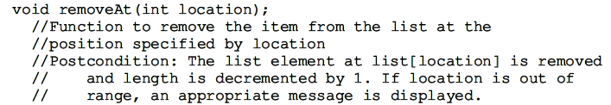
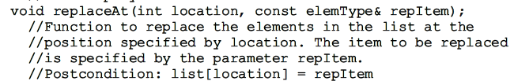
Continue:
Array-Based Lists

Slide 35
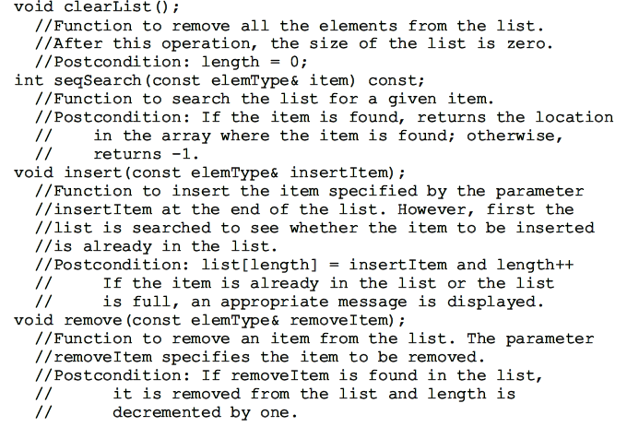
Continue:
Array-Based Lists

Slide 36

Search Algorithm (Linear Search)
Array-Based Lists
For example, we have a list:
Suppose we want to determine whether 27 is in the list. First, you compare 27 with list[0]—that is, compare 27 with 35.
then compare 27 with list[1] that is, with 12.
you compare 27 with the next element in the list—that is, compare 27 with list[2]. Because list[2] = 27, the search stops.

Slide 37
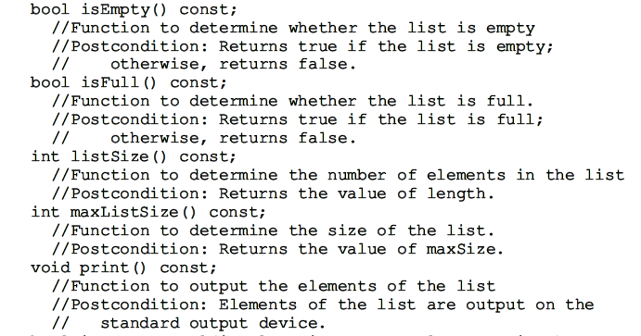
Array-Based Lists

Slide 38
Array-Based Lists
Coding (search function)
template <class elemType>
int arrayListType<elemType>::seqSearch(const elemType& item) const
{ int loc;
bool found = false;
for (loc = 0; loc < length; loc++)
if (list[loc] == item)
{ found = true;
break; }
if (found)
return loc;
else
return -1; }
.

Slide 39
Array-Based Lists
Coding (insert function)
. template <class elemType>
void arrayListType<elemType>::insert(const elemType& insertItem)
{ int loc;
if (length == 0) //list is empty
list[length++] = insertItem; //insert the item
else if (length == maxSize)
cerr << "Cannot insert in a full list." << endl;
else { loc = seqSearch(insertItem);
if (loc == -1) //the item does not exist in the list
list[length++] = insertItem;
else cerr << "the item to be inserted is already in "
<< "the list. No duplicates are allowed." << endl; } }

Slide 40
Array-Based Lists
Coding (remove function)
template<class elemType>
void arrayListType<elemType>::remove(const elemType& removeItem)
{ int loc;
if (length == 0)
cerr << "Cannot delete from an empty list." << endl;
else{
loc = seqSearch(removeItem);
if (loc != -1)
removeAt(loc);
else
cout << "The item to be deleted is not in the list."<< endl; } }
.

Slide 41
Thank You

